Slide 1


Data Analysis and Visualisation with Python
Q-Step Workshop – 06/11/2019
Lewys Brace
l.brace@Exeter.ac.uk

Slide 2
Numerical Python (NumPy)
NumPy is the most foundational package for numerical computing in Python.
If you are going to work on data analysis or machine learning projects, then having a solid understanding of NumPy is nearly mandatory.
Indeed, many other libraries, such as pandas and scikit-learn, use NumPy’s array objects as the lingua franca for data exchange.
One of the reasons as to why NumPy is so important for numerical computations is because it is designed for efficiency with large arrays of data. The reasons for this include:
- It stores data internally in a continuous block of memory, independent of other in-built Python objects.
- It performs complex computations on entire arrays without the need for for loops.

Slide 3
What you’ll find in NumPy
ndarray: an efficient multidimensional array providing fast array-orientated arithmetic operations and flexible broadcasting capabilities.
Mathematical functions for fast operations on entire arrays of data without having to write loops.
Tools for reading/writing array data to disk and working with memory-mapped files.
Linear algebra, random number generation, and Fourier transform capabilities.
A C API for connecting NumPy with libraries written in C, C++, and FORTRAN. This is why Python is the language of choice for wrapping legacy codebases.

Slide 4
The NumPy ndarray: A multi-dimensional array object
The NumPy ndarray object is a fast and flexible container for large data sets in Python.
NumPy arrays are a bit like Python lists, but are still a very different beast at the same time.
Arrays enable you to store multiple items of the same data type. It is the facilities around the array object that makes NumPy so convenient for performing math and data manipulations.

Slide 5
Ndarray vs. lists
By now, you are familiar with Python lists and how incredibly useful they are.
So, you may be asking yourself: “I can store numbers and other objects in a Python list and do all sorts of computations and manipulations through list comprehensions, for-loops etc. What do I need a NumPy array for?”
There are very significant advantages of using NumPy arrays overs lists.

Slide 6


Creating a NumPy array
To understand these advantages, lets create an array.
One of the most common, of the many, ways to create a NumPy array is to create one from a list by passing it to the np.array() function.
In:
Out:

Slide 7
Differences between lists and ndarrays
The key difference between an array and a list is that arrays are designed to handle vectorised operations while a python lists are not.
That means, if you apply a function, it is performed on every item in the array, rather than on the whole array object.

Slide 8




Let’s suppose you want to add the number 2 to every item in the list. The intuitive way to do this is something like this:
In:
Out:
That was not possible with a list, but you can do that on an array:
In:
Out:

Slide 9
It should be noted here that, once a Numpy array is created, you cannot increase its size.
To do so, you will have to create a new array.

Slide 10


Create a 2d array from a list of list
You can pass a list of lists to create a matrix-like a 2d array.
In:
Out:

Slide 11


The dtype argument
You can specify the data-type by setting the dtype() argument.
Some of the most commonly used NumPy dtypes are: float, int, bool, str, and object.
In:
Out:

Slide 12
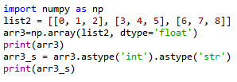
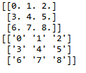
The astype argument
You can also convert it to a different data-type using the astype method.
In:
Out:
Remember that, unlike lists, all items in an array have to be of the same type.

Slide 13

dtype=‘object’
However, if you are uncertain about what data type your array will hold, or if you want to hold characters and numbers in the same array, you can set the dtype as 'object'.
In:
Out:

Slide 14

The tolist() function
You can always convert an array into a list using the tolist() command.
In:
Out:

Slide 15
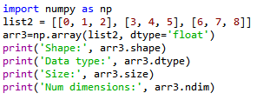

Inspecting a NumPy array
There are a range of functions built into NumPy that allow you to inspect different aspects of an array:
In:
Out:

Slide 16


Extracting specific items from an array
You can extract portions of the array using indices, much like when you’re working with lists.
Unlike lists, however, arrays can optionally accept as many parameters in the square brackets as there are number of dimensions
In:
Out:

Slide 17


Boolean indexing
A boolean index array is of the same shape as the array-to-be-filtered, but it only contains TRUE and FALSE values.
In:
Out:

Slide 18
Pandas
Pandas, like NumPy, is one of the most popular Python libraries for data analysis.
It is a high-level abstraction over low-level NumPy, which is written in pure C.
Pandas provides high-performance, easy-to-use data structures and data analysis tools.
There are two main structures used by pandas; data frames and series.

Slide 19


Indices in a pandas series
A pandas series is similar to a list, but differs in the fact that a series associates a label with each element. This makes it look like a dictionary.
If an index is not explicitly provided by the user, pandas creates a RangeIndex ranging from 0 to N-1.
Each series object also has a data type.
In:
Out:

Slide 20




As you may suspect by this point, a series has ways to extract all of the values in the series, as well as individual elements by index.
In:
Out:
You can also provide an index manually.
In:
Out:

Slide 21
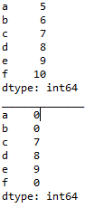

It is easy to retrieve several elements of a series by their indices or make group assignments.
Out:
In:

Slide 22
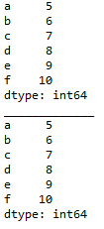
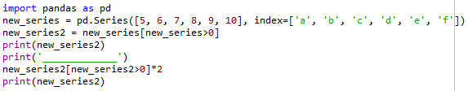
Filtering and maths operations
Filtering and maths operations are easy with Pandas as well.
In:
Out:

Slide 23
Pandas data frame
Simplistically, a data frame is a table, with rows and columns.
Each column in a data frame is a series object.
Rows consist of elements inside series.
Case ID | Variable one | Variable two | Variable 3
1 | 123 | ABC | 10
2 | 456 | DEF | 20
3 | 789 | XYZ | 30

Slide 24
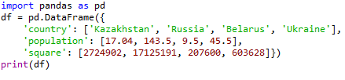

Creating a Pandas data frame
Pandas data frames can be constructed using Python dictionaries.
In:
Out:

Slide 25

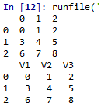
You can also create a data frame from a list.
In:
Out:

Slide 26
You can ascertain the type of a column with the type() function.
In:
Out:

Slide 27
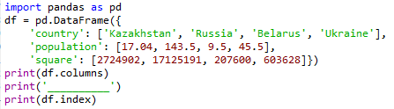

A Pandas data frame object as two indices; a column index and row index.
Again, if you do not provide one, Pandas will create a RangeIndex from 0 to N-1.
In:
Out:

Slide 28
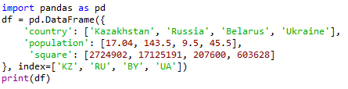

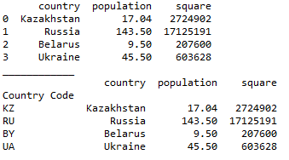
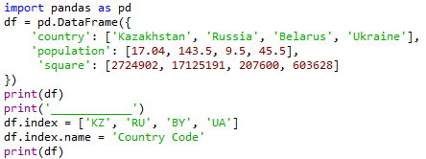
There are numerous ways to provide row indices explicitly.
For example, you could provide an index when creating a data frame:
In:
Out:
or do it during runtime.
Here, I also named the index ‘country code’.
Out:
In:

Slide 29

Row access using index can be performed in several ways.
First, you could use .loc() and provide an index label.
In:
Out:
Second, you could use .iloc() and provide an index number
Out:
In:

Slide 30


A selection of particular rows and columns can be selected this way.
In:
Out:
You can feed .loc() two arguments, index list and column list, slicing operation is supported as well:
In:
Out:

Slide 31

Filtering
Filtering is performed using so-called Boolean arrays.

Slide 32



Deleting columns
You can delete a column using the drop() function.
In:
Out:
In:
Out:

Slide 33
Reading from and writing to a file
Pandas supports many popular file formats including CSV, XML, HTML, Excel, SQL, JSON, etc.
Out of all of these, CSV is the file format that you will work with the most.
You can read in the data from a CSV file using the read_csv() function.
Similarly, you can write a data frame to a csv file with the to_csv() function.

Slide 34
Pandas has the capacity to do much more than what we have covered here, such as grouping data and even data visualisation.
However, as with NumPy, we don’t have enough time to cover every aspect of pandas here.

Slide 35
Exploratory data analysis (EDA)
Exploring your data is a crucial step in data analysis. It involves:
Organising the data set
Plotting aspects of the data set
Maybe producing some numerical summaries; central tendency and spread, etc.
“Exploratory data analysis can never be the whole story, but nothing else can serve as the foundation stone.” - John Tukey.

Slide 36

Download the data
Download the Pokemon dataset from:
https://github.com/LewBrace/da_and_vis_python
Unzip the folder, and save the data file in a location you’ll remember.

Slide 37
Reading in the data
First we import the Python packages we are going to use.
Then we use Pandas to load in the dataset as a data frame.
NOTE: The argument index_col argument states that we'll treat the first column of the dataset as the ID column.
NOTE: The encoding argument allows us to by pass an input error created by special characters in the data set.

Slide 38
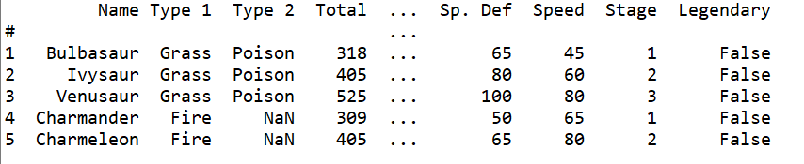
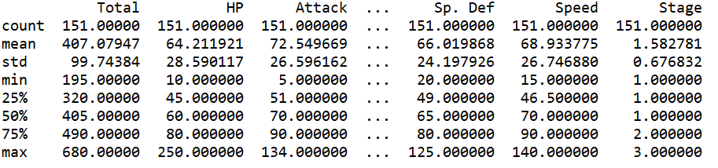
Examine the data set

Slide 39
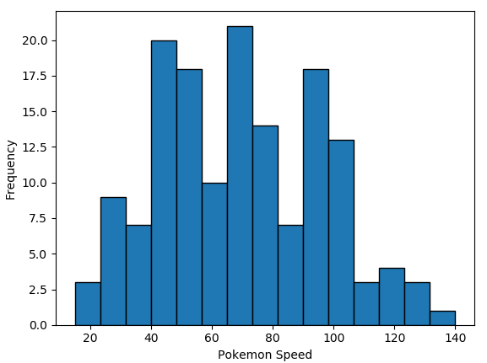
We could spend time staring at these numbers, but that is unlikely to offer us any form of insight.
We could begin by conducting all of our statistical tests.
However, a good field commander never goes into battle without first doing a recognisance of the terrain…
This is exactly what EDA is for…

Slide 40
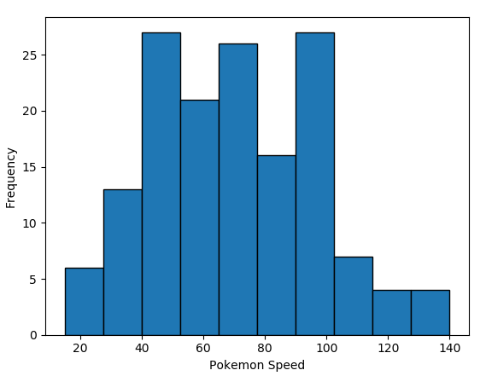

Plotting a histogram in Python

Slide 41
Bins
You may have noticed the two histograms we’ve seen so far look different, despite using the exact same data.
This is because they have different bin values.
The left graph used the default bins generated by plt.hist(), while the one on the right used bins that I specified.

Slide 42

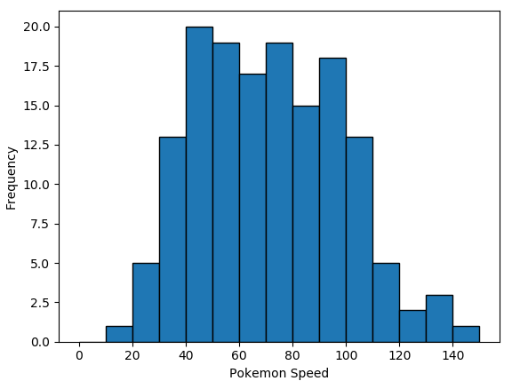
There are a couple of ways to manipulate bins in matplotlib.
Here, I specified where the edges of the bars of the histogram are; the bin edges.

Slide 43

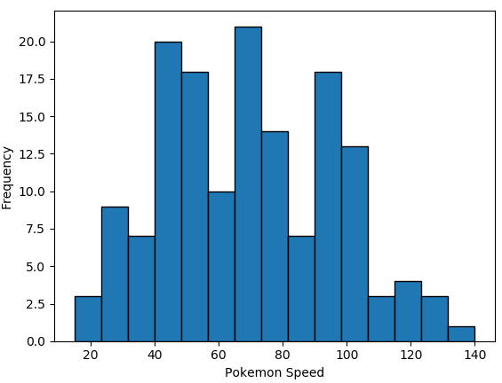
You could also specify the number of bins, and Matplotlib will automatically generate a number of evenly spaced bins.

Slide 44
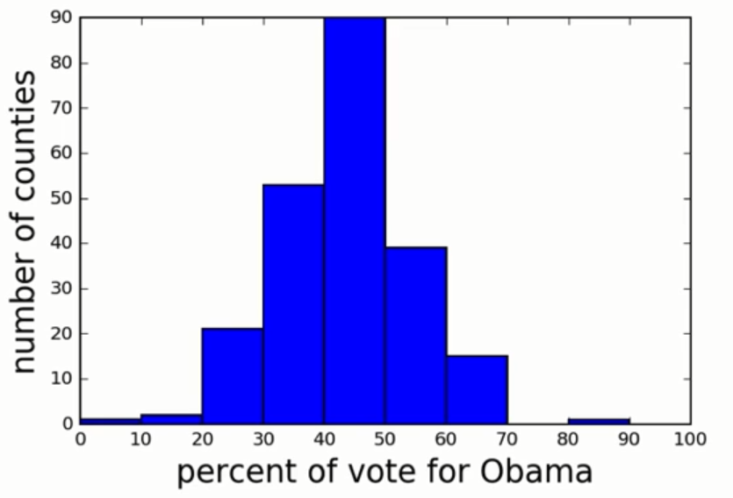
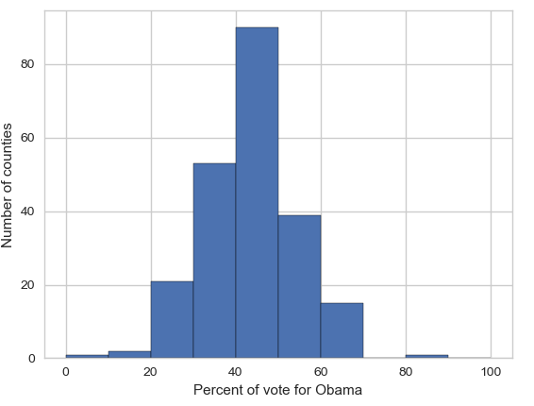
Seaborn
Matplotlib is a powerful, but sometimes unwieldy, Python library.
Seaborn provides a high-level interface to Matplotlib and makes it easier to produce graphs like the one on the right.
Some IDEs incorporate elements of this “under the hood” nowadays.

Slide 45
Benefits of Seaborn
Seaborn offers:
- Using default themes that are aesthetically pleasing.
- Setting custom colour palettes.
- Making attractive statistical plots.
- Easily and flexibly displaying distributions.
- Visualising information from matrices and DataFrames.
The last three points have led to Seaborn becoming the exploratory data analysis tool of choice for many Python users.

Slide 46
Plotting with Seaborn
One of Seaborn's greatest strengths is its diversity of plotting functions.
Most plots can be created with one line of code.
For example….

Slide 47
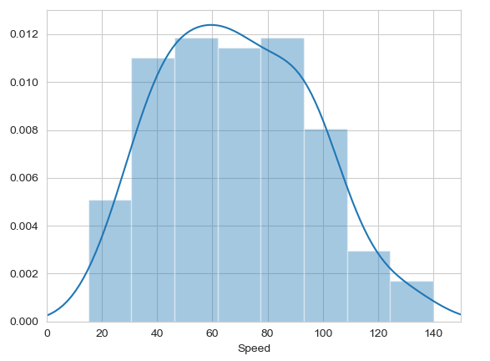

Histograms
Allow you to plot the distributions of numeric variables.

Slide 48
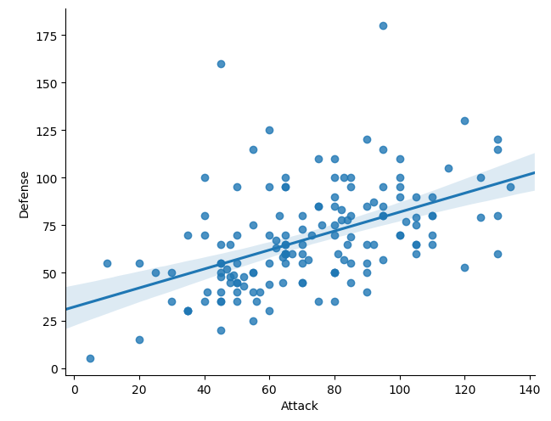
Other types of graphs: Creating a scatter plot
Name of our dataframe fed to the “data=“ command
Name of variable we want on the x-axis
Seaborn “linear model plot” function for creating a scatter graph
Name of variable we want on the y-axis

Slide 49
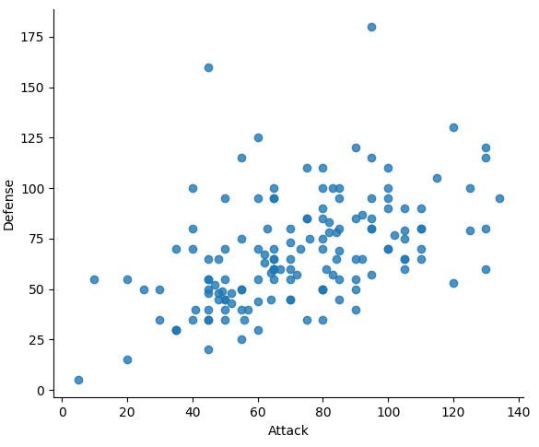
Seaborn doesn't have a dedicated scatter plot function.
We used Seaborn's function for fitting and plotting a regression line; hence lmplot()
However, Seaborn makes it easy to alter plots.
To remove the regression line, we use the fit_reg=False command

Slide 50
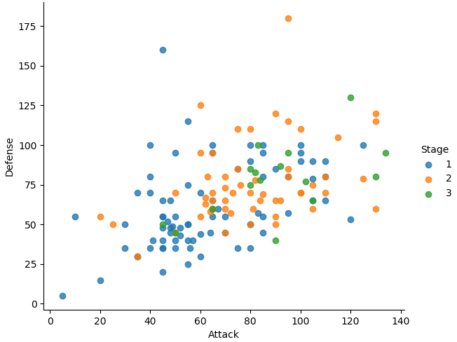

The hue function
Another useful function in Seaborn is the hue function, which enables us to use a variable to colour code our data points.

Slide 51
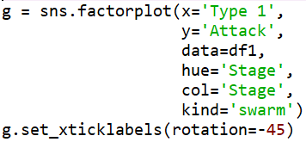
Factor plots
Make it easy to separate plots by categorical classes.
Colour by stage.
Separate by stage.
Generate using a swarmplot.
Rotate axis on x-ticks by 45 degrees.

Slide 52
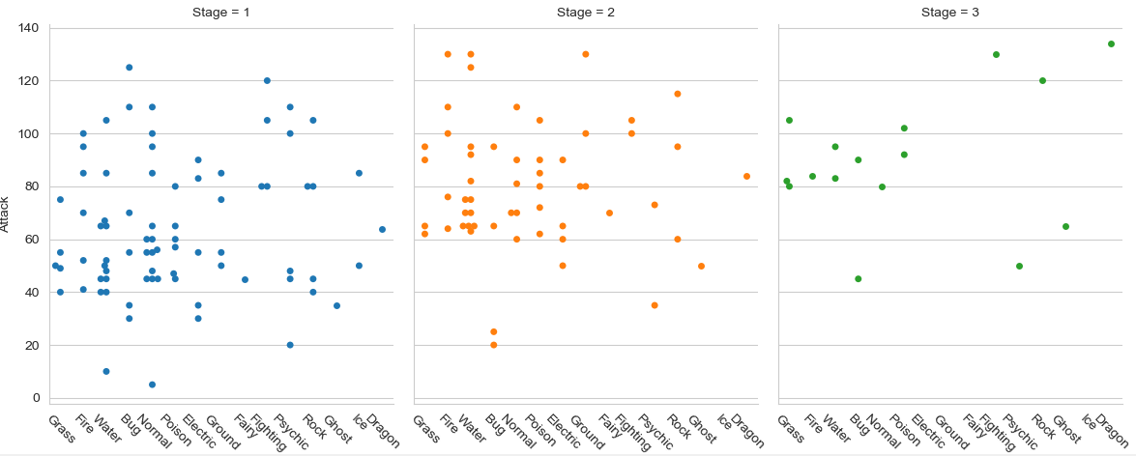

Slide 53
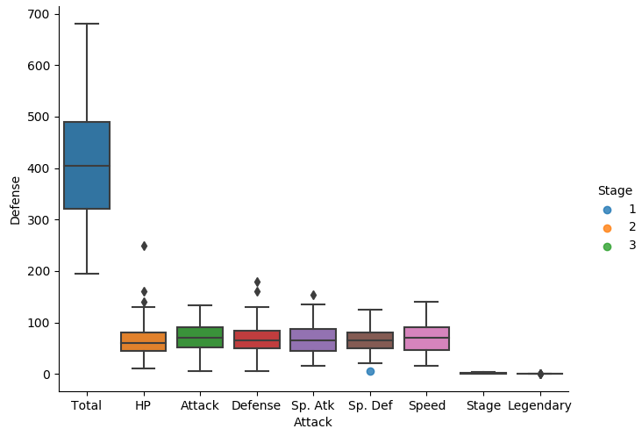

A box plot

Slide 54
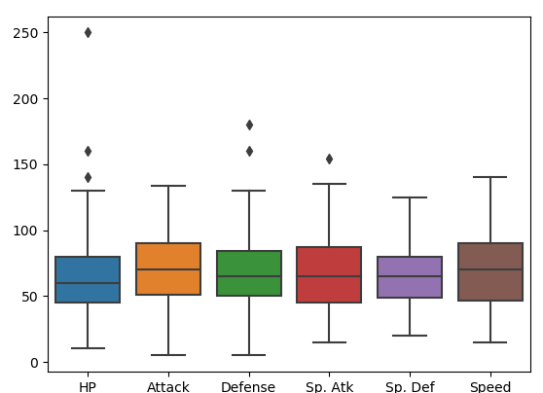
The total, stage, and legendary entries are not combat stats so we should remove them.
Pandas makes this easy to do, we just create a new dataframe
We just use Pandas’ .drop() function to create a dataframe that doesn’t include the variables we don’t want.

Slide 55
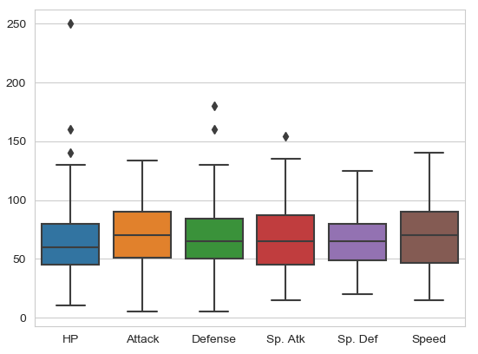

Seaborn’s theme
Seaborn has a number of themes you can use to alter the appearance of plots.
For example, we can use “whitegrid” to add grid lines to our boxplot.

Slide 56
Violin plots
Violin plots are useful alternatives to box plots.
They show the distribution of a variable through the thickness of the violin.
Here, we visualise the distribution of attack by Pokémon's primary type:

Slide 57
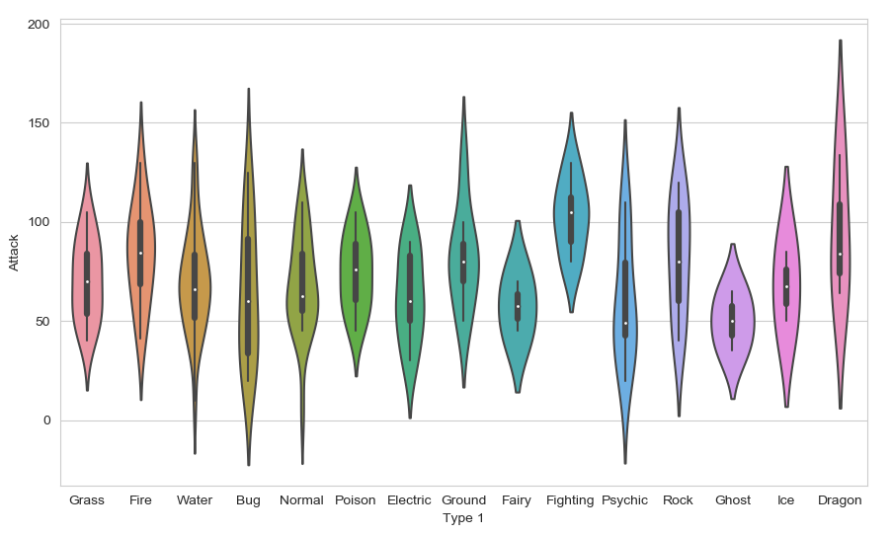
Dragon types tend to have higher Attack stats than Ghost types, but they also have greater variance. But there is something not right here….
The colours!

Slide 58
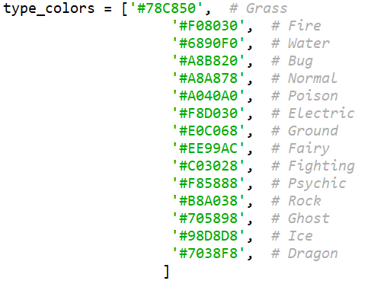
Seaborn’s colour palettes
Seaborn allows us to easily set custom colour palettes by providing it with an ordered list of colour hex values.
We first create our colours list.

Slide 59
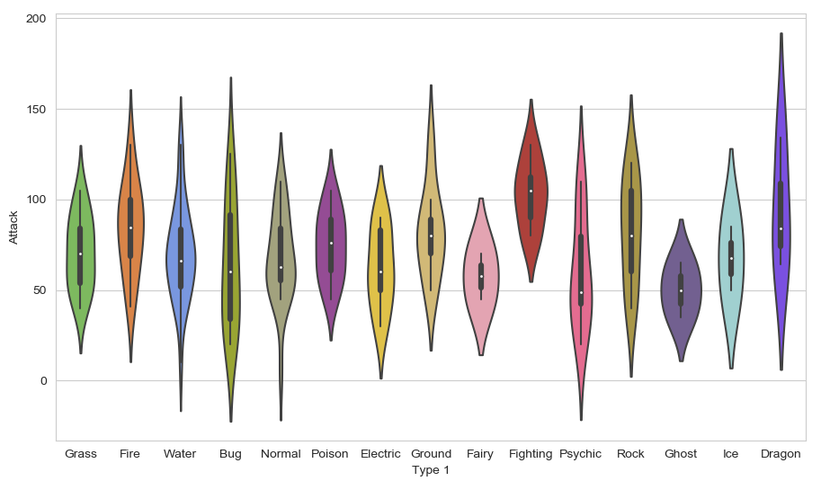
Then we just use the palette= function and feed in our colours list.

Slide 60
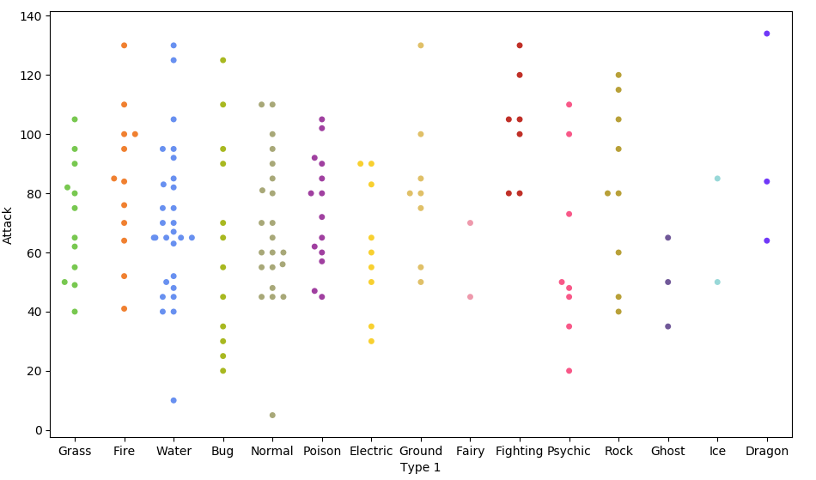

Because of the limited number of observations, we could also use a swarm plot.
Here, each data point is an observation, but data points are grouped together by the variable listed on the x-axis.

Slide 61
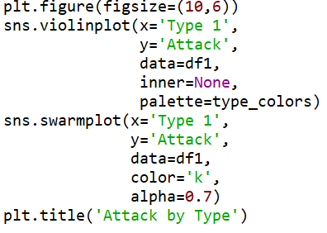
Overlapping plots
Both of these show similar information, so it might be useful to overlap them.
Set size of print canvas.
Remove bars from inside the violins
Make bars black and slightly transparent
Give the graph a title

Slide 62
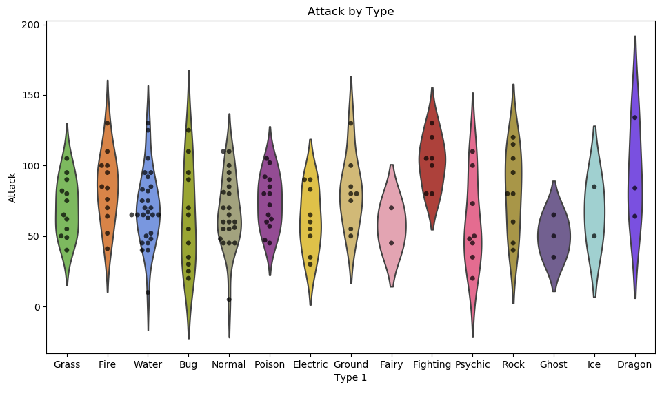

Slide 63
Data wrangling with Pandas
What if we wanted to create such a plot that included all of the other stats as well?
In our current dataframe, all of the variables are in different columns:

Slide 64
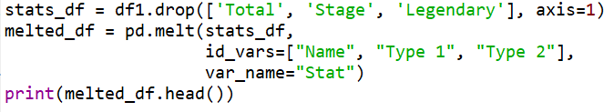
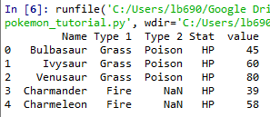


If we want to visualise all stats, then we’ll have to “melt” the dataframe.
We use the .drop() function again to re-create the dataframe without these three variables.
The dataframe we want to melt.
The variables to keep, all others will be melted.
A name for the new, melted, variable.
All 6 of the stat columns have been "melted" into one, and the new Stat column indicates the original stat (HP, Attack, Defense, Sp. Attack, Sp. Defense, or Speed).
It's hard to see here, but each pokemon now has 6 rows of data; hende the melted_df has 6 times more rows of data.

Slide 65
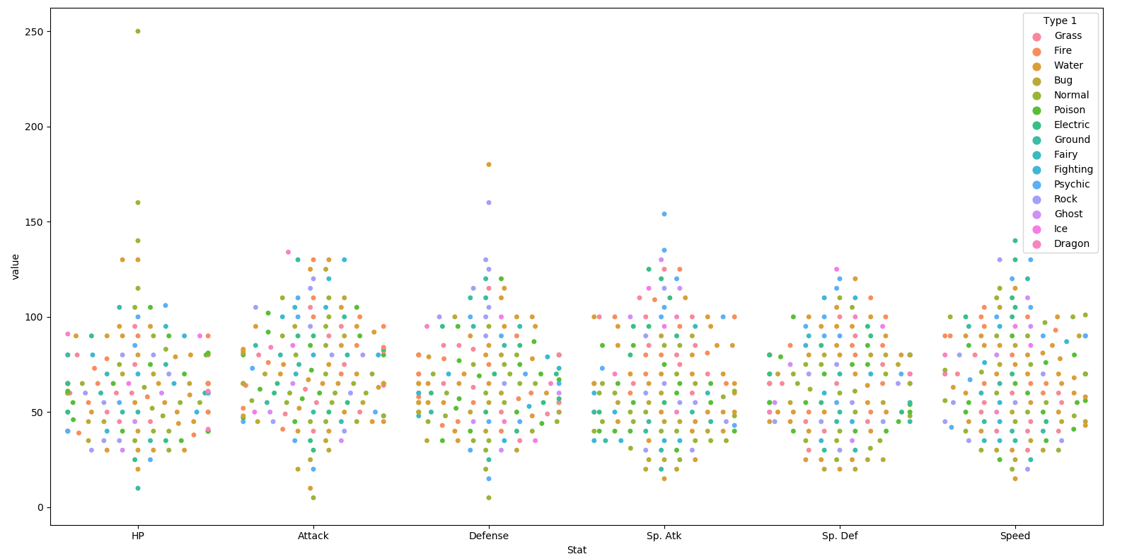

Slide 66
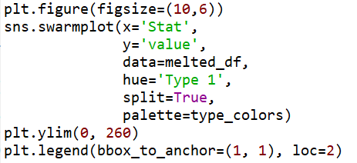
This graph could be made to look nicer with a few tweaks.
Enlarge the plot.
Separate points by hue.
Use our special Pokemon colour palette.
Adjust the y-axis.
Move the legend box outside of the graph and place to the right of it..

Slide 67
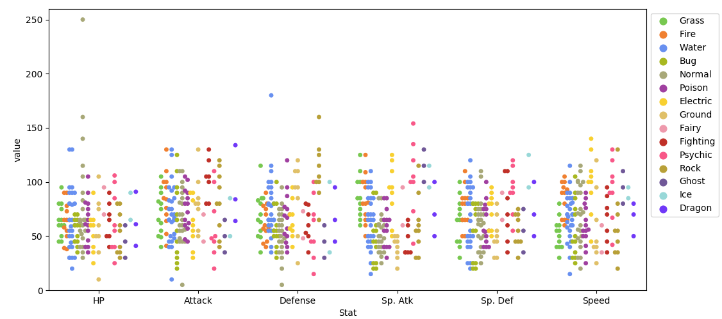

Slide 68
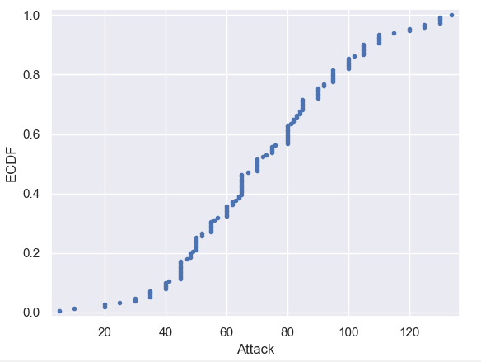
Plotting all data: Empirical cumulative distribution functions (ECDFs)
An alternative way of visualising a distribution of a variable in a large dataset is to use an ECDF.
Here we have an ECDF that shows the percentages of different attack strengths of pokemon.
An x-value of an ECDF is the quantity you are measuring; i.e. attacks strength.
The y-value is the fraction of data points that have a value smaller than the corresponding x-value. For example…

Slide 69
75% of Pokemon have an attack level of 90 or less
20% of Pokemon have an attack level of 50 or less.

Slide 70
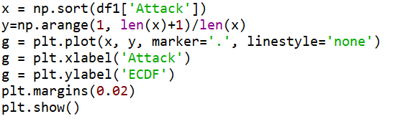
Plotting an ECDF
Notes:
The y-axis is evenly spaced data points with a maximum of 1.

Slide 71
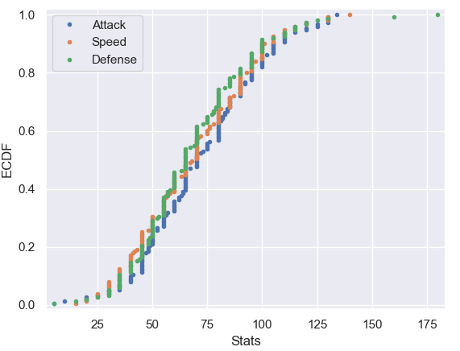
You can also plot multiple ECDFs on the same plot.
As an example, here with have an ECDF for Pokemon attack, speed, and defence levels.
We can see here that defence levels tend to be a little less than the other two.

Slide 72
The usefulness of ECDFs
It is often quite useful to plot the ECDF first as part of your workflow.
It shows all the data and gives a complete picture as to how the data are distributed.

Slide 73
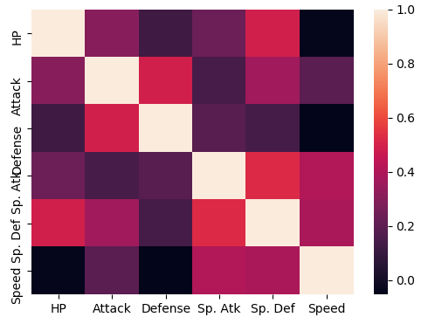

Heatmaps
Useful for visualising matrix-like data.
Here, we’ll plot the correlation of the stats_df variables

Slide 74
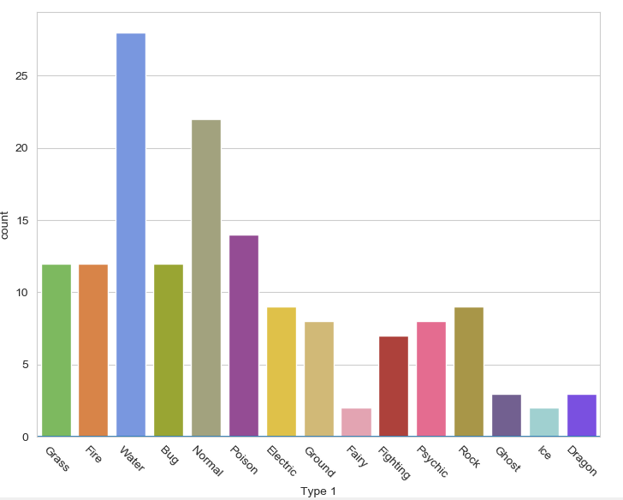

Bar plot
Visualises the distributions of categorical variables.
Rotates the x-ticks 45 degrees

Slide 75
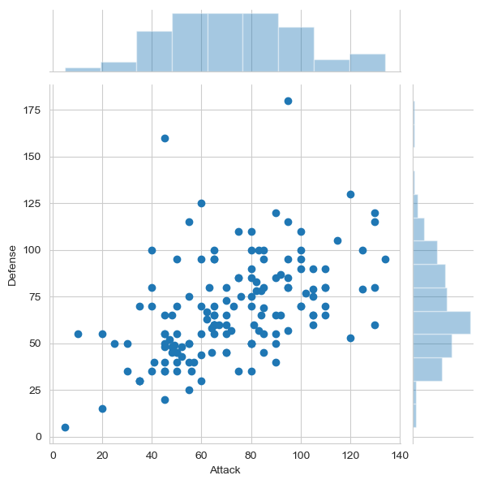

Joint Distribution Plot
Joint distribution plots combine information from scatter plots and histograms to give you detailed information for bi-variate distributions.

Slide 76
Any questions?

